Slide 1
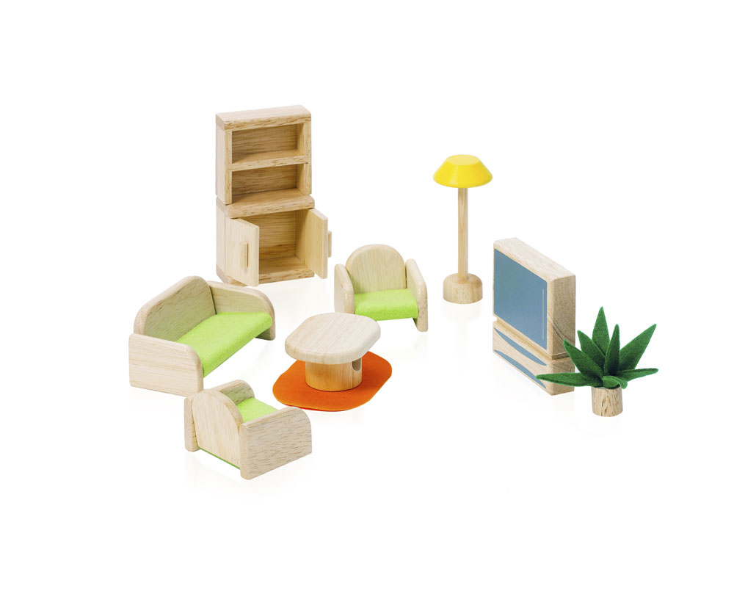
kamer
stoel
tafel
kast
plant
kleedje
lamp

